Slide 1

Name: Md. Abir Rahman
Department: Computer Science & Engineering
Course Title: Structured Programming
Course Code: CSE-103
Section: 20
Academic Session: Fall 2023
Academic Term: Final-term
Date: 11-12-2023
Instructor: Dr. Md. Atiqur Rahman

Slide 2

What is Structured Programming?

Slide 3

Structured programming, or modular programming, is a programming paradigm that facilitates the creation of programs with readable code and reusable components. All modern programming languages support structured programming, but the mechanisms of support -- like the syntax of the programming languages -- vary.

Slide 4

Examples
of
structured programming languages:
C
Pascal
Java
C++
Python

Slide 5

Today we will solve a Problem by C Language.

Slide 6

Which is related with our daily life problem.

Slide 7

Way Too Long Words

Slide 8

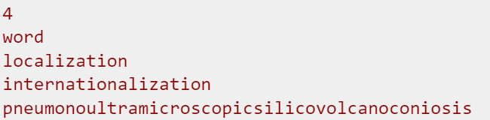
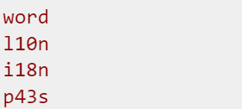
Sometimes some words like "localization" or "internationalization" are so long that writing them many times in one text is quite tiresome.
Let's consider a word too long, if its length is strictly more than 10 characters. All too long words should be replaced with a special abbreviation.
This abbreviation is made like this: we write down the first and the last letter of a word and between them we write the number of letters between the first and the last letters. That number is in decimal system and doesn't contain any leading zeroes.
Thus, "localization" will be spelt as "l10n", and "internationalization» will be spelt as "i18n".
You are suggested to automatize the process of changing the words with abbreviations. At that all too long words should be replaced by the abbreviation and the words that are not too long should not undergo any changes.
Input
The input data contains one word. All the words consist of lowercase letters and possess the lengths of from 1 to 100 characters.
Output
Print n lines. The i-th line should contain the result of replacing of the i-th word from the input data.
Examples:
Way Too Long Words
Input
Output

Slide 9

Core Concepts:
Array & String.
Control Statements (Loop).
Logical Operators.
Use input & output.

Slide 10

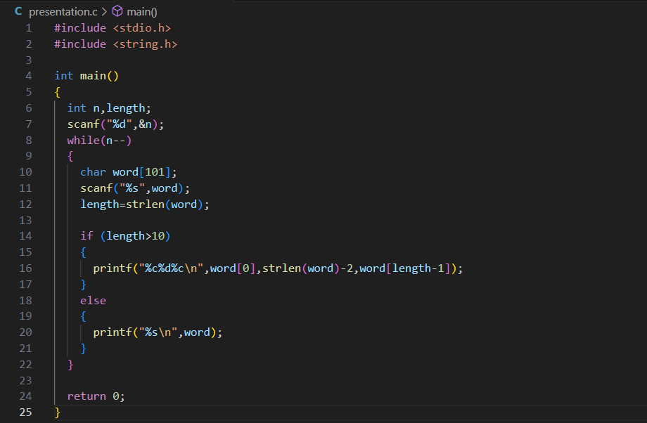

Slide 11
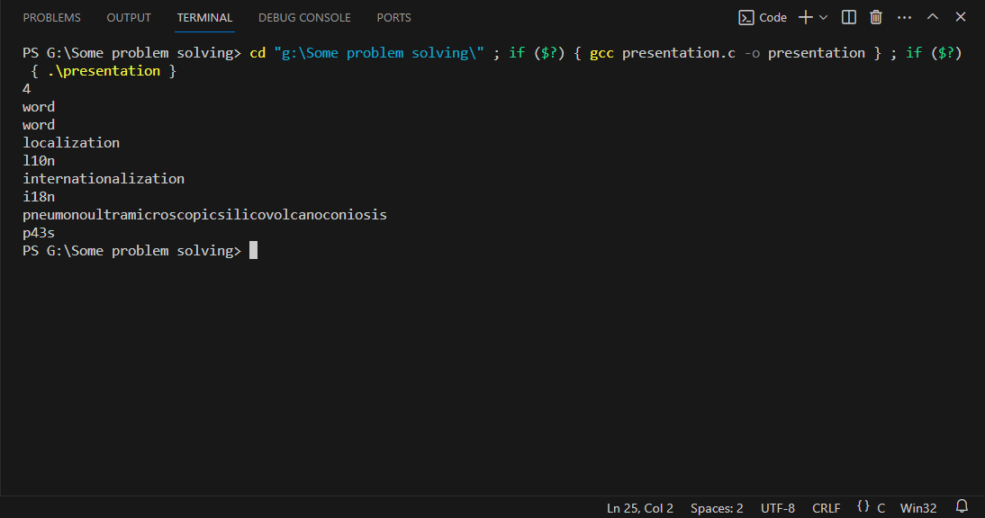


Slide 12





Congratulations, Our Code has passed all the Test Cases.

Slide 13


Thank You.

